Slide 1
How to set up your GetConnected account
Business Account Edition

Slide 2
Introduction
This guide is designed for those in the property development and water services sectors, including Self-Lay Providers, New Appointment and Variation (NAVs) companies, property developers, and consultants. It will walk you through the process of setting up a Business account on our online portal.
Choosing the Business option is ideal for companies or professionals working on large projects. To create a Business account, you’ll need to provide your company number from UK Companies House. Once set up, your account can be shared with colleagues or consultants working on your behalf, making it easier to collaborate on tasks like submitting applications, managing progress, and responding to queries.
The primary purpose of setting up your account is to allow you to submit and manage applications for connecting to the water network, ensuring a smooth and efficient process.
If you ever have any questions, you can reach us by phone on 0330 303 0119

Slide 3
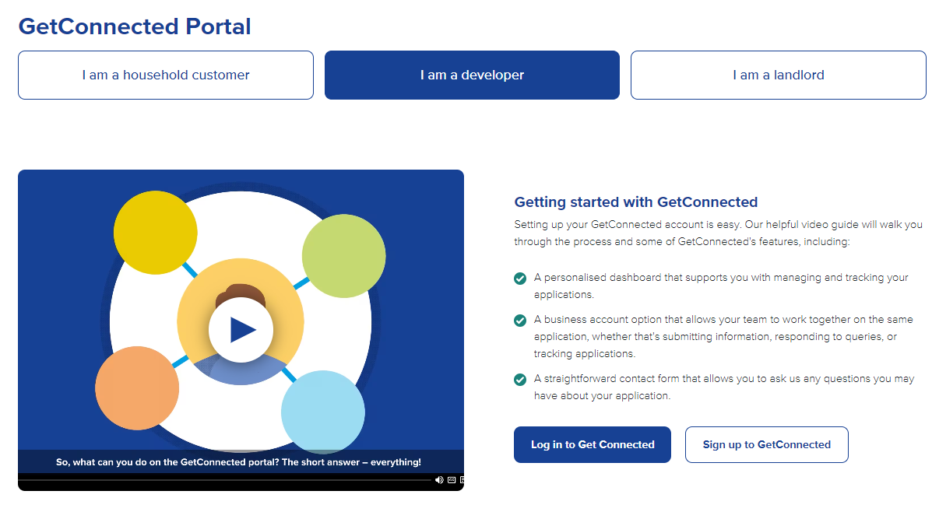
Setting up your GetConnected Business account
Visit the GetConnected page on our website
Select ‘Login’ if you are an existing customer or ‘Sign up’ to create your account

Slide 4
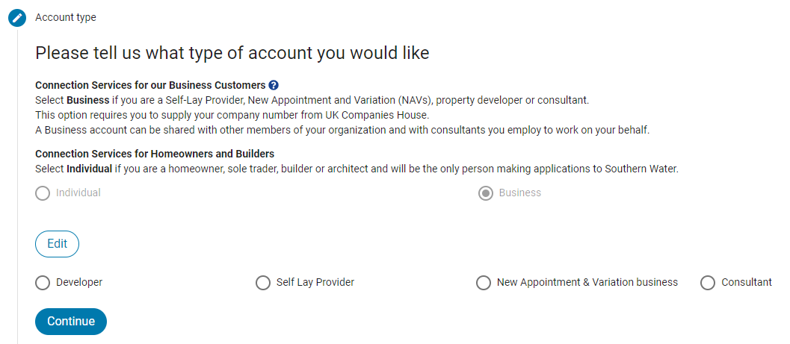
Setting up your GetConnected Business account
Register your account under Individual or Business according to how you’ll use it
Please go to the next slide to read more

Slide 5
Connection services for our Business customers
If you work for a company registered in the UK and are likely to work on more than one development site in the Southern Water area, then you should select a business account.
You will be asked to nominate someone to act as Company Admin who will then be able to authorise other staff members or consultants working for your business to make applications on your behalf.
If you are likely to be the only person making applications then you can nominate yourself as the Company Admin. A business account allows anyone you authorise to view and make changes to any application submitted to Southern Water using this online service via a shared Company Dashboard.
We will ensure that at least one person from the business acts as an authoriser to confirm who can see the shared Company Dashboard on Get Connected.
If you are only likely to make a one-off application to Southern Water it may be easier to select an Individual account.

Slide 6
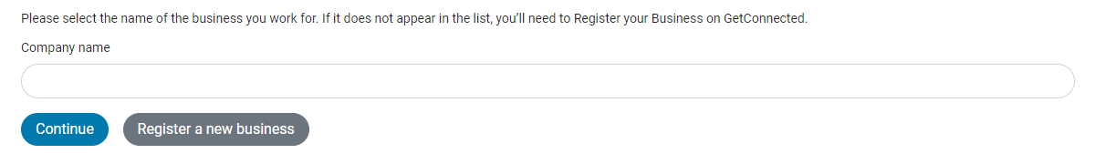
Setting up your GetConnected Business account
Start typing your Business name to find it in the dropdown list
If it’s not there, please select ‘Register a new business’

Slide 7
Register a new business
To create your business account, we’ll collect your company details and verify them with Companies House. After that, we'll contact you to confirm who will be the Company Admin, which can be you or another person with a Get Connected account.
The Company Admin manages access to your business data and can authorise others, such as staff or consultants, to view and manage applications for your business. If you’re the first to register your business, you'll automatically become the Admin.
If you're a sole trader, we recommend choosing a Personal account instead.
Once your business is set up, we'll contact you. For assistance, call 0330 303 0119 and ask for business account admin.

Slide 8
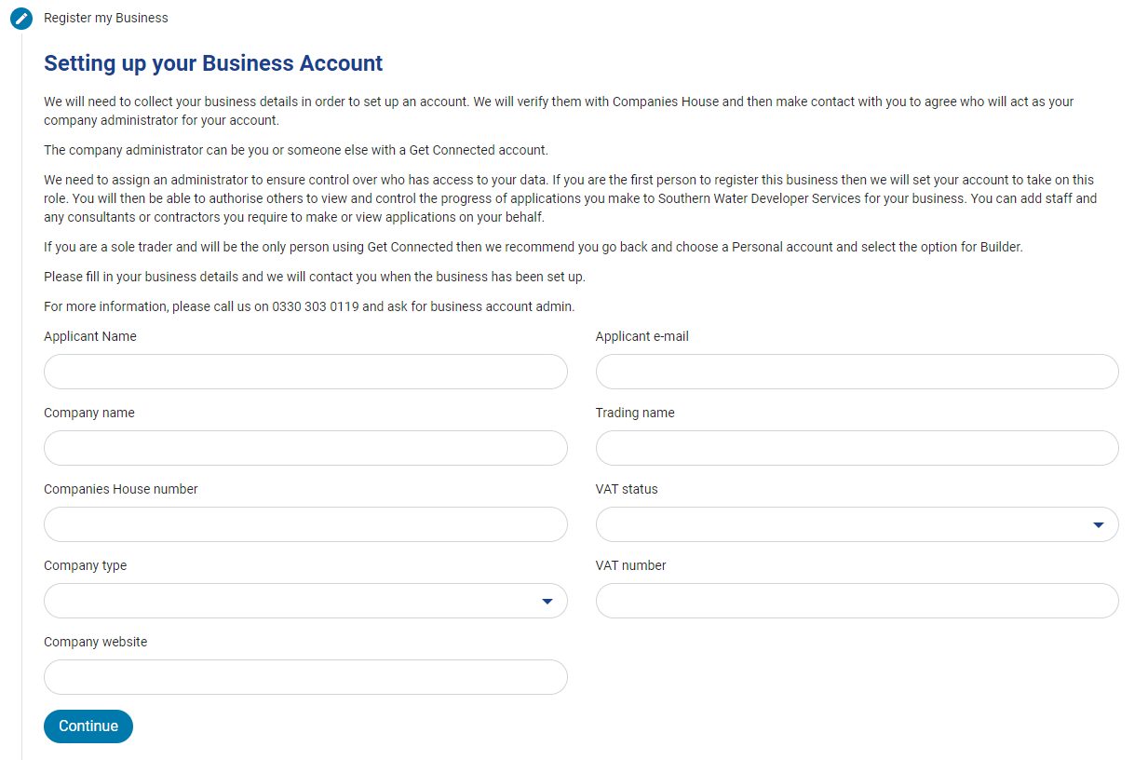
Setting up your GetConnected Business account
Please provide your business details along with your contact information

Slide 9
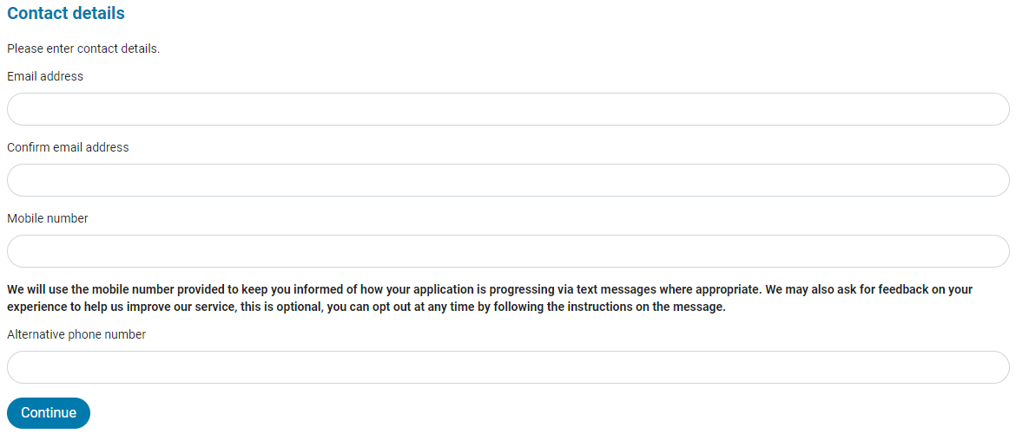
Setting up your GetConnected Business account
Enter your name and contact details in the appropriate fields so we can stay in touch with you as your application moves forward

Slide 10
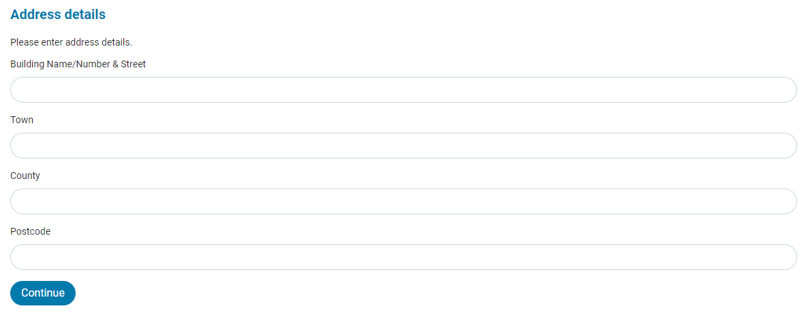
Setting up your GetConnected Business account
Fill out your address details

Slide 11
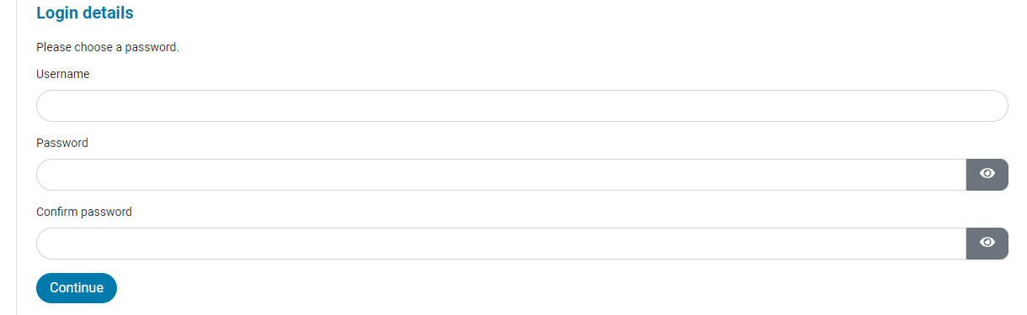
Setting up your GetConnected Business account
Choose a Username and Password to log into your account
Please do not use your email address as your Username

Slide 12
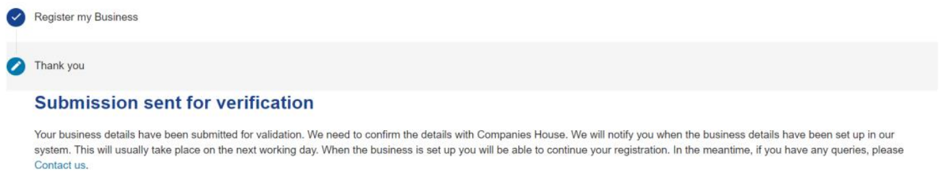
Setting up your GetConnected Business account
All done! Our team will check your details and set up a business account for you. This usually takes 1 working day.

Slide 13
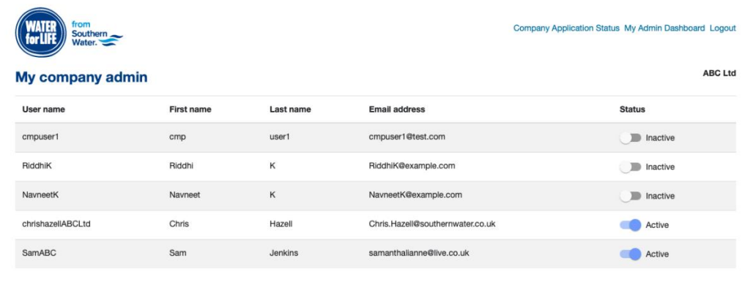
Setting up your GetConnected Business account
Once your business account is setup, your admin will be able to manage user permissions in GetConnected.

Slide 14
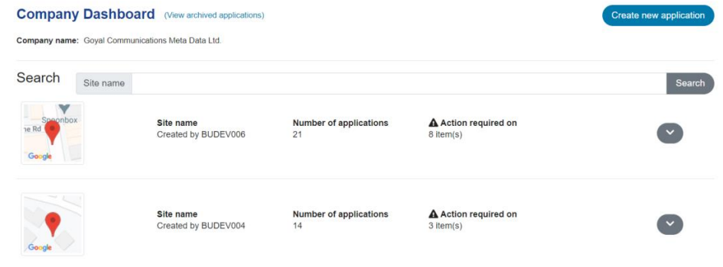
Setting up your GetConnected Business account
All users that have access to your business account in GetConnected will be able to monitor application progress using GetConnected Dashboard.

