Slide 1
How to set up your GetConnected account

Slide 2
Introduction
Our GetConnected portal is designed to make things easier for all our Developer Services customers, whether you're working on large property developments or simply making improvements to your home, like building that dream extension.
Once you've created an account, you'll have access to a personalised dashboard where you can easily manage and track your applications. For businesses, there's also the option to set up a team account, so your colleagues can work together on the same application—whether it’s submitting documents, answering our queries, or keeping track of progress.
If you ever have any questions, you can reach us by phone on 0330 303 0119

Slide 3
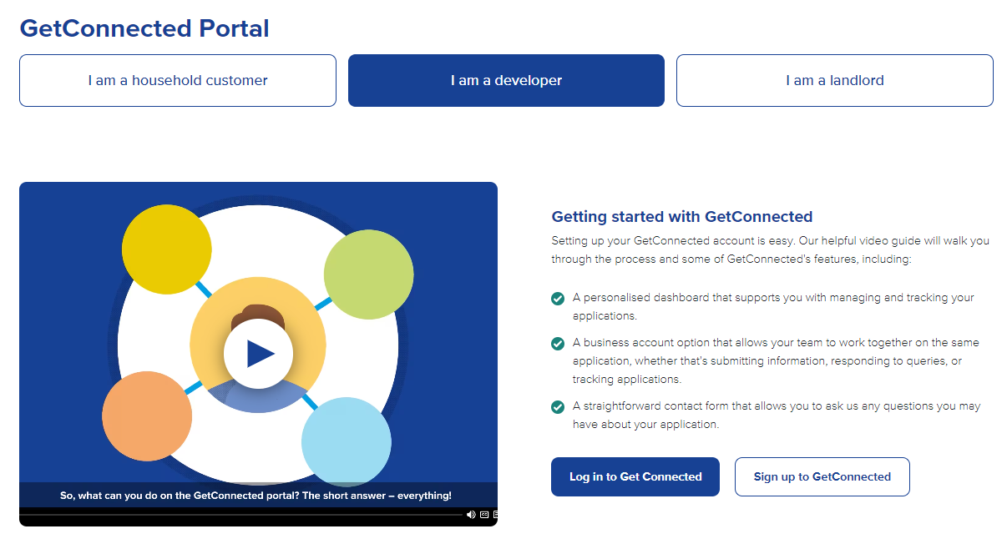
Setting up your GetConnected account
Visit the GetConnected page on our website
Select ‘Login’ if you are an existing customer or ‘Sign up’ to create your account

Slide 4
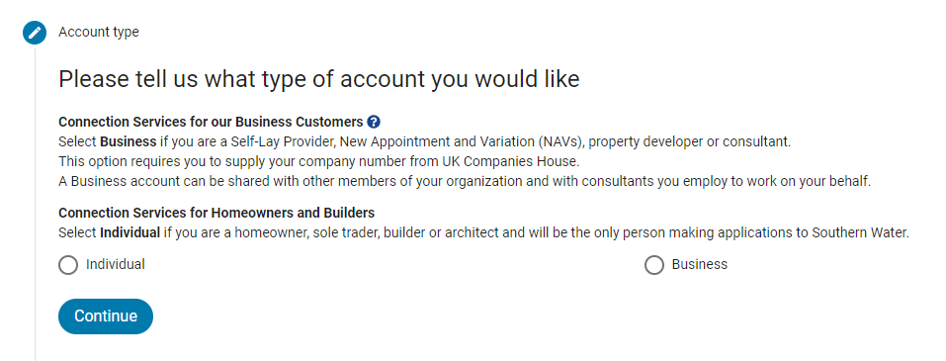
Setting up your GetConnected account
Register your account under Individual or Business according to how you’ll use it
If you need some support with setting up a Business account then we have a guide for that too.

Slide 5
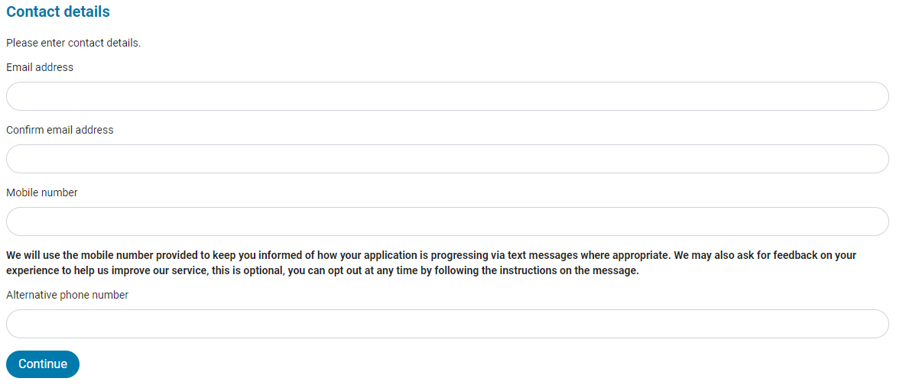
Setting up your GetConnected account
Enter your name and contact details in the appropriate fields so we can stay in touch with you as your application moves forward

Slide 6
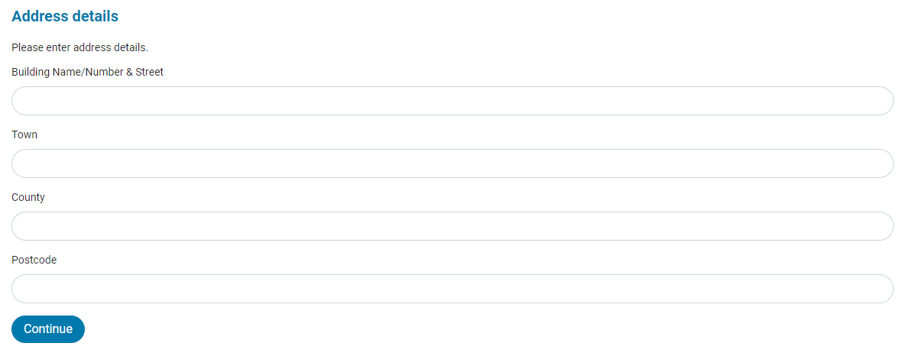
Setting up your GetConnected account
Fill out your address details

Slide 7
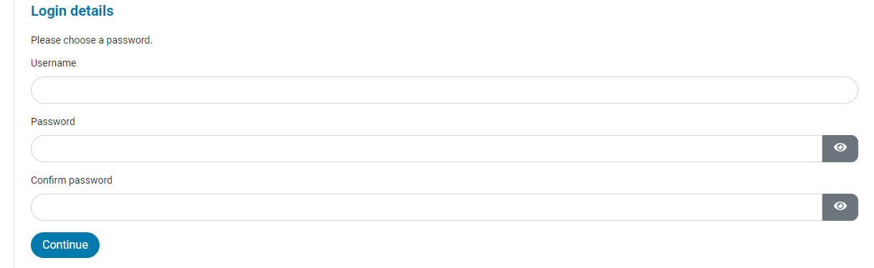
Setting up your GetConnected account
Choose a Username and Password to log into your account
Please do not use your email address as your Username

Slide 8
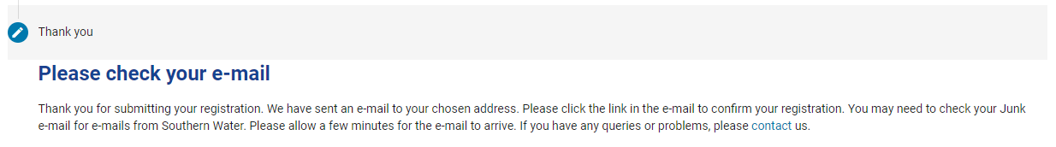
Setting up your GetConnected account
Check your email to confirm registration and log into your account
Tip: Please allow a few minutes and then check your junk mail if it hasn’t arrived

