Slide 1
Requesting access to your existing business account

Slide 2
Introduction
This guide is designed for those in the property development and water services sectors, including Self-Lay Providers, New Appointment and Variation (NAVs) companies, property developers, and consultants. It will walk you through the process of setting up a Business account on our online portal.
Choosing the Business option is ideal for companies or professionals working on large projects. To create a Business account, you’ll need to provide your company number from UK Companies House. Once set up, your account can be shared with colleagues or consultants working on your behalf, making it easier to collaborate on tasks like submitting applications, managing progress, and responding to queries.
The primary purpose of setting up your account is to allow you to submit and manage applications for connecting to the water network, ensuring a smooth and efficient process.
If you ever have any questions, you can reach us by phone on 0330 303 0119

Slide 3
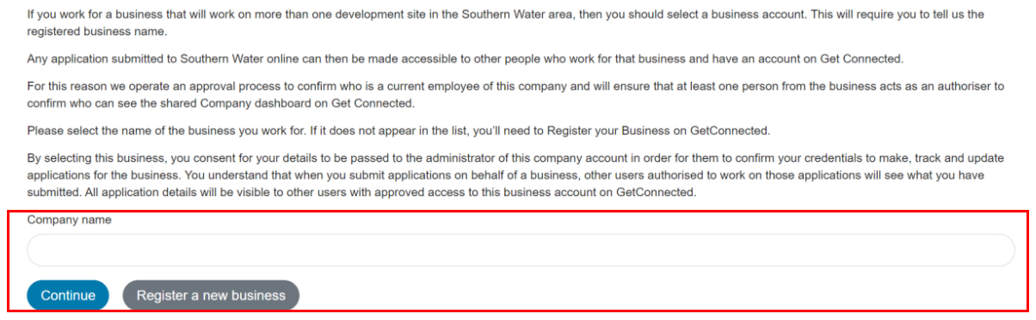
Requesting access to your existing business account
Enter the name of the business account you wish to access. If the business is already set up, its name will appear in the dropdown menu as you begin typing.

Slide 4
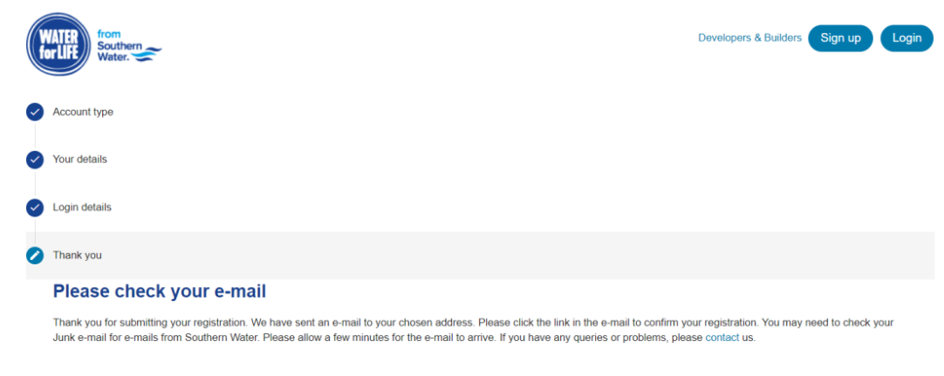
Requesting access to your existing business account
A verification email will be sent to the email address you provided. Please check your junk mail if it does not immediately appear in your inbox

Slide 5
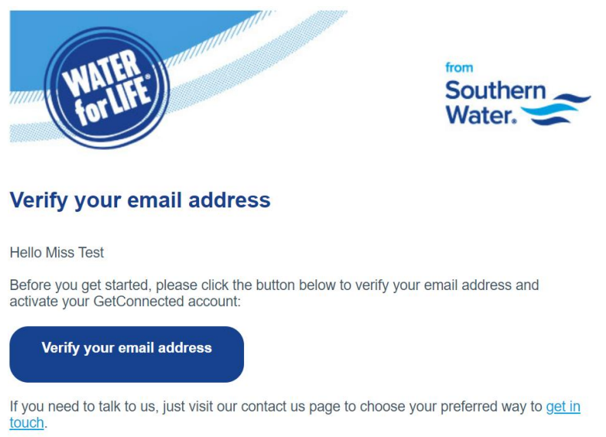
Requesting access to your existing business account
Please verify your email address
At this point in the process, an email will be sent to the Business Admin, informing them that you have requested access to their shared business dashboard

Slide 6
Requesting access to your existing business account
You will be notified via email once the Business Admin has granted access to you.

